Slide 1
Java Interface
In the Java programming language, an interface is a reference type, similar to a class, that can contain only constants, method signatures, default methods, static methods, and nested types. Method bodies exist only for default methods and static methods.
Interfaces cannot be instantiated—they can only be implemented by classes or extended by other interfaces.

Slide 2
Java Interface
To use an interface, you write a class that implements the interface. When an instantiable class implements an interface, it provides a method body for each of the methods declared in the interface.

Slide 3
Java Interface
https://docs.oracle.com/javase/tutorial/java/IandI/createinterface.html

Slide 4
Java Interface
An interface declaration consists of modifiers, the keyword interface, the interface name, a comma-separated list of parent interfaces (if any), and the interface body.
Notes:
public interface GroupedInterface extends Interface1, Interface2, Interface3 { // constant declarations // base of natural logarithms double E = 2.718282; // method signatures void doSomething (int i, double x); int doSomethingElse(String s); }

Slide 5
Java Interface
public interface GroupedInterface extends Interface1, Interface2, Interface3 {
// constant declarations
// base of natural logarithms
double E = 2.718282;
// method signatures
void doSomething (int i, double x);
int doSomethingElse(String s);
}
Notes:
public interface GroupedInterface extends Interface1, Interface2, Interface3 { // constant declarations // base of natural logarithms double E = 2.718282; // method signatures void doSomething (int i, double x); int doSomethingElse(String s); }

Slide 6
Java Interface
The public access specifier indicates that the interface can be used by any class in any package.
If you do not specify that the interface is public, then your interface is accessible only to classes defined in the same package as the interface.
Notes:
The public access specifier indicates that the interface can be used by any class in any package. If you do not specify that the interface is public, then your interface is accessible only to classes defined in the same package as the interface.

Slide 7
Java Interface
An interface can extend other interfaces, just as a class subclass or extend another class. However, whereas a class can extend only one other class, an interface can extend any number of interfaces.
The interface declaration includes a comma-separated list of all the interfaces that it extends.
Notes:
The public access specifier indicates that the interface can be used by any class in any package. If you do not specify that the interface is public, then your interface is accessible only to classes defined in the same package as the interface.

Slide 8
Java Interface
The interface body can contain abstract methods, default methods, and static methods.
An abstract method within an interface is followed by a semicolon, but no braces (an abstract method does not contain an implementation).
Default methods are defined with the default modifier, and
static methods with the static keyword.
All abstract, default, and static methods in an interface are implicitly public, so you can omit the public modifier.
Notes:
The interface body can contain abstract methods, default methods, and static methods. An abstract method within an interface is followed by a semicolon, but no braces (an abstract method does not contain an implementation). Default methods are defined with the default modifier, and static methods with the static keyword. All abstract, default, and static methods in an interface are implicitly public, so you can omit the public modifier.
In addition, an interface can contain constant declarations. All constant values defined in an interface are implicitly public, static, and final. Once again, you can omit these modifiers.

Slide 9
Java Interface
In addition, an interface can contain constant declarations. All constant values defined in an interface are implicitly public, static, and final. Once again, you can omit these modifiers.
Notes:
The interface body can contain abstract methods, default methods, and static methods. An abstract method within an interface is followed by a semicolon, but no braces (an abstract method does not contain an implementation). Default methods are defined with the default modifier, and static methods with the static keyword. All abstract, default, and static methods in an interface are implicitly public, so you can omit the public modifier.
In addition, an interface can contain constant declarations. All constant values defined in an interface are implicitly public, static, and final. Once again, you can omit these modifiers.

Slide 10
Java Interface
interface Shape {
double calculateArea();
double calculatePerimeter();
}
Notes:
// Definiáljuk az interfészt interface Shape { double calculateArea(); // Interfész metódus, amelyet az implementáló osztályoknak meg kell valósítani double calculatePerimeter(); // Második interfész metódus } // Az osztály, amely implementálja az interfészt class Circle implements Shape { private double radius; public Circle(double radius) { this.radius = radius; } @Override public double calculateArea() { return Math.PI * radius * radius; } @Override public double calculatePerimeter() { return 2 * Math.PI * radius; } } public class InterfaceExample { public static void main(String[] args) { Circle circle = new Circle(5.0); System.out.println("Kör területe: " + circle.calculateArea()); System.out.println("Kör kerülete: " + circle.calculatePerimeter()); } }

Slide 11
Java Interface
class Circle implements Shape {
private double radius;
public Circle(double radius) { this.radius = radius; }
@Override
public double calculateArea() {
return Math.PI * radius * radius;
}
@Override
public double calculatePerimeter() {
return 2 * Math.PI * radius;
}
}
Notes:
// Definiáljuk az interfészt interface Shape { double calculateArea(); // Interfész metódus, amelyet az implementáló osztályoknak meg kell valósítani double calculatePerimeter(); // Második interfész metódus } // Az osztály, amely implementálja az interfészt class Circle implements Shape { private double radius; public Circle(double radius) { this.radius = radius; } @Override public double calculateArea() { return Math.PI * radius * radius; } @Override public double calculatePerimeter() { return 2 * Math.PI * radius; } } public class InterfaceExample { public static void main(String[] args) { Circle circle = new Circle(5.0); System.out.println("Kör területe: " + circle.calculateArea()); System.out.println("Kör kerülete: " + circle.calculatePerimeter()); } }

Slide 12
Java Interface
public class InterfaceExample {
public static void main(String[] args) {
Circle circle = new Circle(5.0);
System.out.println("Kör területe: " +
circle.calculateArea());
System.out.println("Kör kerülete: " +
circle.calculatePerimeter());
}
}
Notes:
// Definiáljuk az interfészt interface Shape { double calculateArea(); // Interfész metódus, amelyet az implementáló osztályoknak meg kell valósítani double calculatePerimeter(); // Második interfész metódus } // Az osztály, amely implementálja az interfészt class Circle implements Shape { private double radius; public Circle(double radius) { this.radius = radius; } @Override public double calculateArea() { return Math.PI * radius * radius; } @Override public double calculatePerimeter() { return 2 * Math.PI * radius; } } public class InterfaceExample { public static void main(String[] args) { Circle circle = new Circle(5.0); System.out.println("Kör területe: " + circle.calculateArea()); System.out.println("Kör kerülete: " + circle.calculatePerimeter()); } }

Slide 13
Java Interface
Default method
Default methods enable you to add new functionality to the interfaces of your libraries and ensure binary compatibility with code written for older versions of those interfaces.
Notes:
// Definiáljuk az interfészt interface Shape { double calculateArea(); // Interfész metódus, amelyet az implementáló osztályoknak meg kell valósítani double calculatePerimeter(); // Második interfész metódus } // Az osztály, amely implementálja az interfészt class Circle implements Shape { private double radius; public Circle(double radius) { this.radius = radius; } @Override public double calculateArea() { return Math.PI * radius * radius; } @Override public double calculatePerimeter() { return 2 * Math.PI * radius; } } public class InterfaceExample { public static void main(String[] args) { Circle circle = new Circle(5.0); System.out.println("Kör területe: " + circle.calculateArea()); System.out.println("Kör kerülete: " + circle.calculatePerimeter()); } }

Slide 14
Java Interface
Default method
In a typical design based on abstractions, where an interface has one or multiple implementations, if one or more methods are added to the interface, all the implementations will be forced to implement them too. Otherwise, the design will just break down.
Default interface methods are an efficient way to deal with this issue. They allow us to add new methods to an interface that are automatically available in the implementations. Therefore, we don't need to modify the implementing classes.
In this way, backward compatibility is neatly preserved without having to refactor the implementers.
Notes:
// Definiáljuk az interfészt interface Shape { double calculateArea(); // Interfész metódus, amelyet az implementáló osztályoknak meg kell valósítani double calculatePerimeter(); // Második interfész metódus } // Az osztály, amely implementálja az interfészt class Circle implements Shape { private double radius; public Circle(double radius) { this.radius = radius; } @Override public double calculateArea() { return Math.PI * radius * radius; } @Override public double calculatePerimeter() { return 2 * Math.PI * radius; } } public class InterfaceExample { public static void main(String[] args) { Circle circle = new Circle(5.0); System.out.println("Kör területe: " + circle.calculateArea()); System.out.println("Kör kerülete: " + circle.calculatePerimeter()); } }

Slide 15
Java Interface
public interface Vehicle {
String getBrand();
String speedUp();
String slowDown();
default String turnAlarmOn() {
return "Turning the vehicle alarm on.";
}
default String turnAlarmOff() {
return "Turning the vehicle alarm off.";
}
}
Notes:
// Definiáljuk az interfészt interface Shape { double calculateArea(); // Interfész metódus, amelyet az implementáló osztályoknak meg kell valósítani double calculatePerimeter(); // Második interfész metódus } // Az osztály, amely implementálja az interfészt class Circle implements Shape { private double radius; public Circle(double radius) { this.radius = radius; } @Override public double calculateArea() { return Math.PI * radius * radius; } @Override public double calculatePerimeter() { return 2 * Math.PI * radius; } } public class InterfaceExample { public static void main(String[] args) { Circle circle = new Circle(5.0); System.out.println("Kör területe: " + circle.calculateArea()); System.out.println("Kör kerülete: " + circle.calculatePerimeter()); } }

Slide 16
Java Interface
public class Car implements Vehicle {
private String brand;
@Override
public String getBrand() { return brand; }
@Override
public String speedUp() { return "The car is speeding up."; }
@Override
public String slowDown() { return "The car is slowing down."; }
}
Notes:
// Definiáljuk az interfészt interface Shape { double calculateArea(); // Interfész metódus, amelyet az implementáló osztályoknak meg kell valósítani double calculatePerimeter(); // Második interfész metódus } // Az osztály, amely implementálja az interfészt class Circle implements Shape { private double radius; public Circle(double radius) { this.radius = radius; } @Override public double calculateArea() { return Math.PI * radius * radius; } @Override public double calculatePerimeter() { return 2 * Math.PI * radius; } } public class InterfaceExample { public static void main(String[] args) { Circle circle = new Circle(5.0); System.out.println("Kör területe: " + circle.calculateArea()); System.out.println("Kör kerülete: " + circle.calculatePerimeter()); } }

Slide 17
Java Interface
public static void main(String[] args) {
Vehicle car = new Car("BMW");
System.out.println(car.getBrand());
System.out.println(car.speedUp());
System.out.println(car.slowDown());
System.out.println(car.turnAlarmOn());
System.out.println(car.turnAlarmOff());
}
Notes:
// Definiáljuk az interfészt interface Shape { double calculateArea(); // Interfész metódus, amelyet az implementáló osztályoknak meg kell valósítani double calculatePerimeter(); // Második interfész metódus } // Az osztály, amely implementálja az interfészt class Circle implements Shape { private double radius; public Circle(double radius) { this.radius = radius; } @Override public double calculateArea() { return Math.PI * radius * radius; } @Override public double calculatePerimeter() { return 2 * Math.PI * radius; } } public class InterfaceExample { public static void main(String[] args) { Circle circle = new Circle(5.0); System.out.println("Kör területe: " + circle.calculateArea()); System.out.println("Kör kerülete: " + circle.calculatePerimeter()); } }

Slide 18
Java Interface
Default method
If at some point we decide to add more default methods to the Vehicle interface, the application will still continue working, and we won't have to force the class to provide implementations for the new methods.
The most common use of interface default methods is to incrementally provide additional functionality to a given type without breaking down the implementing classes.
Notes:
// Definiáljuk az interfészt interface Shape { double calculateArea(); // Interfész metódus, amelyet az implementáló osztályoknak meg kell valósítani double calculatePerimeter(); // Második interfész metódus } // Az osztály, amely implementálja az interfészt class Circle implements Shape { private double radius; public Circle(double radius) { this.radius = radius; } @Override public double calculateArea() { return Math.PI * radius * radius; } @Override public double calculatePerimeter() { return 2 * Math.PI * radius; } } public class InterfaceExample { public static void main(String[] args) { Circle circle = new Circle(5.0); System.out.println("Kör területe: " + circle.calculateArea()); System.out.println("Kör kerülete: " + circle.calculatePerimeter()); } }

Slide 19
Java Interface
Static method
public interface Vehicle {
static int getHorsePower(int rpm, int torque) {
return (rpm * torque) / 5252;
}
}
Meghívni:
Vehicle.getHorsePower(2500, 480));
Notes:
// Definiáljuk az interfészt interface Shape { double calculateArea(); // Interfész metódus, amelyet az implementáló osztályoknak meg kell valósítani double calculatePerimeter(); // Második interfész metódus } // Az osztály, amely implementálja az interfészt class Circle implements Shape { private double radius; public Circle(double radius) { this.radius = radius; } @Override public double calculateArea() { return Math.PI * radius * radius; } @Override public double calculatePerimeter() { return 2 * Math.PI * radius; } } public class InterfaceExample { public static void main(String[] args) { Circle circle = new Circle(5.0); System.out.println("Kör területe: " + circle.calculateArea()); System.out.println("Kör kerülete: " + circle.calculatePerimeter()); } }

Slide 20
Java Interface
Use interface
When you define a new interface, you are defining a new reference data type. You can use interface names anywhere you can use any other data type name. If you define a reference variable whose type is an interface, any object you assign to it must be an instance of a class that implements the interface.
Notes:
// Definiáljuk az interfészt interface Shape { double calculateArea(); // Interfész metódus, amelyet az implementáló osztályoknak meg kell valósítani double calculatePerimeter(); // Második interfész metódus } // Az osztály, amely implementálja az interfészt class Circle implements Shape { private double radius; public Circle(double radius) { this.radius = radius; } @Override public double calculateArea() { return Math.PI * radius * radius; } @Override public double calculatePerimeter() { return 2 * Math.PI * radius; } } public class InterfaceExample { public static void main(String[] args) { Circle circle = new Circle(5.0); System.out.println("Kör területe: " + circle.calculateArea()); System.out.println("Kör kerülete: " + circle.calculatePerimeter()); } }

Slide 21
Java Interface
Methods in an interface that are not declared as default or static are implicitly abstract, so the abstract modifier is not used with interface methods. (It can be used, but it is unnecessary.)
Notes:
Methods in an interface (see the Interfaces section) that are not declared as default or static are implicitly abstract, so the abstract modifier is not used with interface methods. (It can be used, but it is unnecessary.)

Slide 22
Java Interface and inheritance
A Class can implement more interfaces.
Olvasmány a hallgatóknak
https://docs.oracle.com/javase/tutorial/java/IandI/multipleinheritance.html

Slide 23
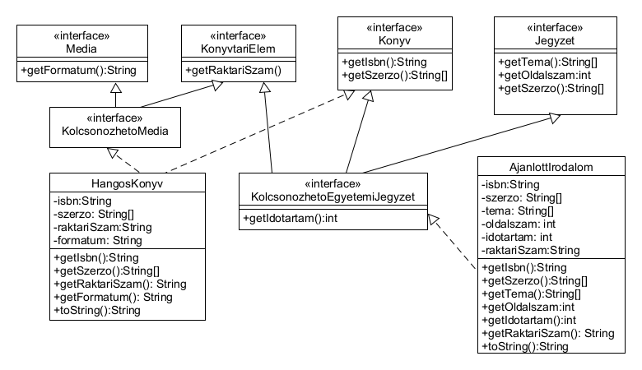

Slide 24
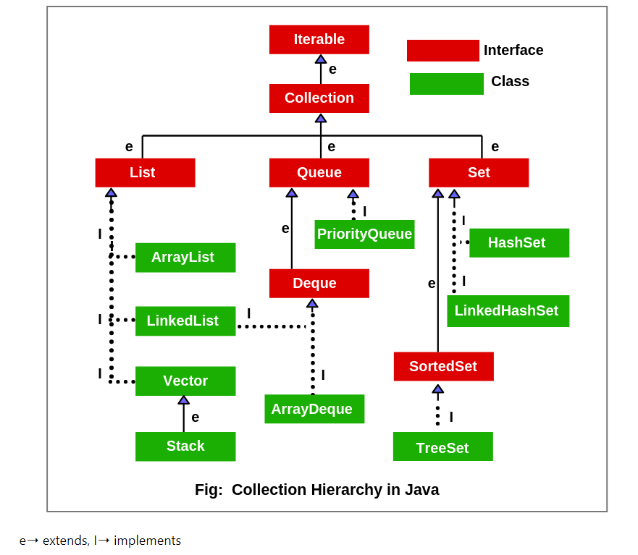

Slide 25
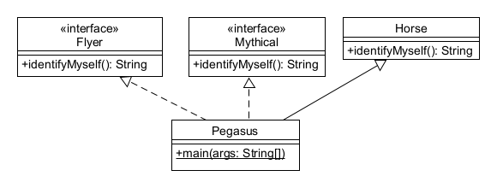

Slide 26
Java Inheritance (öröklés)
public class Horse {
public String identifyMyself() { return "I am a horse."; } }
public interface Flyer {
default public String identifyMyself(){return "I am able to fly.";}}
public interface Mythical {
default public String identifyMyself() {
return "I am a mythical creature."; } }
public class Pegasus extends Horse implements Flyer, Mythical {
public static void main(String... args) {
Pegasus myApp = new Pegasus();
System.out.println(myApp.identifyMyself()); } }
„I am a horse.”
Notes:
public class Horse { public String identifyMyself() { return "I am a horse."; } }public interface Flyer { default public String identifyMyself() { return "I am able to fly."; } }public interface Mythical { default public String identifyMyself() { return "I am a mythical creature."; } }public class Pegasus extends Horse implements Flyer, Mythical { public static void main(String... args) { Pegasus myApp = new Pegasus(); System.out.println(myApp.identifyMyself()); } }

Slide 27
Java Inheritance (öröklés)
Interface Methods
Default methods and abstract methods in interfaces are inherited like instance methods. However, when the supertypes of a class or interface provide multiple default methods with the same signature, the Java compiler follows inheritance rules to resolve the name conflict. These rules are driven by the following two principles:
Instance methods are preferred over interface default methods.
Methods that are already overridden by other candidates are ignored. This circumstance can arise when supertypes share a common ancestor.

Slide 28
Java Inheritance (öröklés)
public interface Animal {
default public String identifyMyself() {
return "I am an animal."; } }
public interface EggLayer extends Animal {
default public String identifyMyself() {
return "I am able to lay eggs."; } }
public interface FireBreather extends Animal { }
public class Dragon implements EggLayer, FireBreather {
public static void main (String... args) {
Dragon myApp = new Dragon();
System.out.println(myApp.identifyMyself()); } }
„I am able to lay eggs.”
Notes:
public interface Animal { default public String identifyMyself() { return "I am an animal."; } }public interface EggLayer extends Animal { default public String identifyMyself() { return "I am able to lay eggs."; } }public interface FireBreather extends Animal { }public class Dragon implements EggLayer, FireBreather { public static void main (String... args) { Dragon myApp = new Dragon(); System.out.println(myApp.identifyMyself()); } }The method Dragon.identifyMyself returns the string I am able to lay eggs.

Slide 29
Java Inheritance (öröklés)
If two or more independently defined default methods conflict, or a default method conflicts with an abstract method, then the Java compiler produces a compiler error. You must explicitly override the supertype methods.
Notes:
public interface Animal { default public String identifyMyself() { return "I am an animal."; } }public interface EggLayer extends Animal { default public String identifyMyself() { return "I am able to lay eggs."; } }public interface FireBreather extends Animal { }public class Dragon implements EggLayer, FireBreather { public static void main (String... args) { Dragon myApp = new Dragon(); System.out.println(myApp.identifyMyself()); } }The method Dragon.identifyMyself returns the string I am able to lay eggs.

Slide 30
Java Inheritance (öröklés)
Static methods in interfaces are never inherited.
Notes:
public interface Animal { default public String identifyMyself() { return "I am an animal."; } }public interface EggLayer extends Animal { default public String identifyMyself() { return "I am able to lay eggs."; } }public interface FireBreather extends Animal { }public class Dragon implements EggLayer, FireBreather { public static void main (String... args) { Dragon myApp = new Dragon(); System.out.println(myApp.identifyMyself()); } }The method Dragon.identifyMyself returns the string I am able to lay eggs.

Slide 31
Java Inheritance and Interface
14_Interface_Inheritance példa
Notes:
public interface Animal { default public String identifyMyself() { return "I am an animal."; } }public interface EggLayer extends Animal { default public String identifyMyself() { return "I am able to lay eggs."; } }public interface FireBreather extends Animal { }public class Dragon implements EggLayer, FireBreather { public static void main (String... args) { Dragon myApp = new Dragon(); System.out.println(myApp.identifyMyself()); } }The method Dragon.identifyMyself returns the string I am able to lay eggs.

